Slide 1
SWM cost structure for the public sector
Ministry of Industrial Development, SMEs and Cooperatives
Inception Workshop on
Industrial Waste Management: Cost Structure Review
Dr. S. Tunesi, International Consultant
prof. D. Surroop, National Consultant
6 February 2020

Slide 2
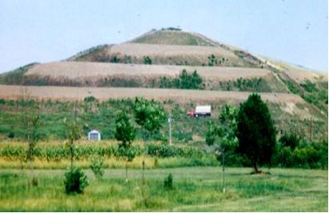
The goals of this project:
Analyse the structure of the costs for Private actors to manage Industrial Waste (in selected industrial sectors)
Analyse the structure of the costs borne by the Public sector in managing Industrial and Municipal waste: the two managements overlap
Underline the need to know the cost of different management alternatives -recycling locally or export; composting or anaerobic digestion; energy recovery;…. – to choose among them
Understand if and what role the Public Sector can play in increasing IW management effectiveness: e.g. incentives and disincentives to reduce landfilling should be part of an overall waste and energy strategy.
X

Slide 3
Industrial waste is part of a
larger picture:
Solid waste management and
health and environmental protection
policies

Slide 4
ClassificaTion of waste
Needs to be clearly defined in the legislation
HOUSEHOLD
classified by origin
Municipal
COMMERCE and BUSINESS:
can be declared ‘similar’ and managed together with household
Industry
Agriculture
Medical
…..
similar waste | Waste which in nature and composition is similar to household waste, even if from other origins, and it can thus be collected, disposed of and treated together with household waste.
Non Hazardous
classified by hazard
Hazardous

Slide 5
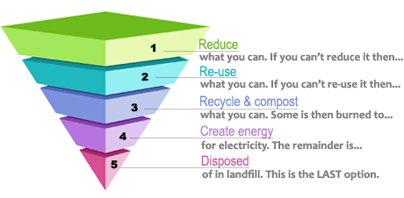
The waste hierarchy should apply to all types of waste
And clear targets need to be given by the legislation
(a) prevention
(b) preparing for re-use
(c) recycling
(d) other recovery, e.g. energy recovery
(e) disposal

Slide 6
How public policies can reduce landfill
1. INPUT of RESOURCES and ENERGY
Construction; Operation; Maintenance; Dismantling
Consumption of electrical energy, of gas for heating and transport.
Fertilisers, soil conditioners for agriculture
Recycling of materials in industries, the building sector, roads.
PREVENTION
THERMAL TREATMENTS energy recovery
WASTES
arisings, composition
COLLECTION
containers, bags, cards
TRANSPORT
pre-TREATMENT of residual waste (MBT)
3. OUTPUT of RESORCES and ENERGY from the WM SISTEM
LANDFILLS hazardous W non–hazardous
INTERMEDIATE PLANTS:
selection of dry fractions
Home
Composting
MATERIAL RECOVERY
ANAEROBIC DIGESTION, COMPOSTING
how to optimise recovery from all types of waste ?
knowing the total costs is an essential element of effective policies
2. EMISSIONS and WASTES to environment

Slide 7
Both Solid Waste Generators – such as Industries - and Service Providers - such as Local Authorities /Governments - need a method to calculate Costs and Tariffs and define Alternatives and Incentives /disincentives
Know your Solid Waste Management system:
Industrial process and waste generation (IWA project in 2016)
The overall SWM system
calculate cost for each activity of management
To define tariffs → Understand the overlap between private and public activities
To define incentives /disincentives → must have clear objectives for environmental protection / recovery from waste

Slide 8
Know your Solid Waste Management system:
The overall SWM system
describing your system is the first step to understand how to control and improve it.
South Africa Gudelines for setting waste managmeent tariffs “In order to set proper tariffs for consumers, all the costs associated with providing the solid waste service should be reflected as accurately as possible. This will help in the design of appropriate tariffs that will ensure that the revenue required to cover these costs is generated.

Slide 9
Waste sources and amounts
waste characteristics - existing and forecast
waste amounts generated yearly per each relevant waste source households commerce and restaurants green waste from public and private parks industries hospitals and health structures ….. | tonnes / year
hazardous waste amounts generated | tonnes / year
municipal waste generated per capita | tonnes / year/ person
formulate scenarios for the amounts generated in future years: forecast on population growth economic forecast on household’s income expected changes in composition forecast on effect of minimisation policies | tonnes / year tonnes / year/ person
composition of the waste Waste characterization is an expensive activity; oftentimes reliable and updated data are not available. Hypothesis can be formulated on the basis of composition available for similar socio-economic situations. | Paper Plastics Food waste Metal cans Textile WEEE C&D …

Slide 10
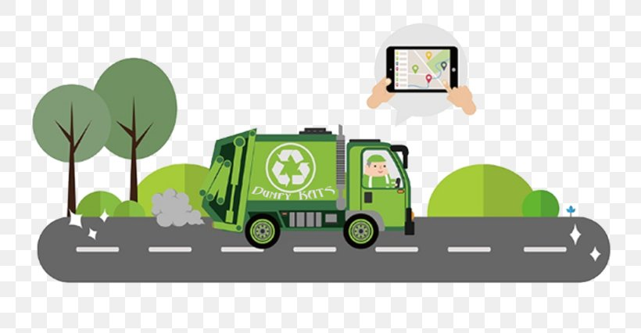
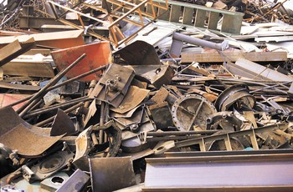
waste sources to be included in SWM public strategy
Account for all sources and amounts: if some streams are excluded from the knowledge base or if the legislation does not set regulations for them, the need for collection and treatment capacity will be underestimated.
Waste legislations often maintains a separation in the responsibilities for SWM: with the public managing municipal waste and the private sector managing production waste.
But the knowledge of the many sources and the quantification of the amounts generated remains the first requisite of planning: even if these waste are not part of the public planning effort they must be part of the knowledge.

Slide 11
waste types to be included in SWM design
waste types : need to be collected separately and managed by specific treatments, and may require specific legislation.
A waste generator may generate several types of waste:
household waste and similar waste
packaging
WEEE: waste of electric and electronic equipment
tyres
end of life vehicles
batteries and accumulators
construction and demolition

Slide 12
A complete vision
Disposal in landfill
RESIDUAL WASTE to LANDFILL
RESIDUAL WASTE to SANITARY LANDFILL
How much of these amounts and costs are from industrial waste ?????
WET FRACTION from MBT to LANDFILL
PRE-treatment of residual W
FERROUS
REPROCESSING
FE from MBT to RECYCLING
Thermal Treatment of residual W
with ENERGY RECOVERY
RESIDUAL WASTE from “door to door”
RESIDUAL waste to TREATMENT
PRE-TREATMENT of RESIDUAL WASTE
DRY FRACTION from MBT to ENERGY RECOVERY
to FE RECOVERY
FERROUS
REPROCESSING
RESIDUAL WASTE from PROXIMITY CONTAINERS
RESIDUAL WASTE to THERMAL TREATMENT
THERMAL TREATMENT with ENERGY RECOVERY
FLY ASHES to LANDFILL
HAZARDOUS WASTE to LANDFILL
BOTTOM ASH to RECOVERY
OTHER
waste type, amount and composition
HOUSEHOLD WASTE
RECOVERY of BOTTOM ASH
intermediate sorting plants from SC
SORTING PLANT for DRY FRACTIONS RECYCLABLES
SANITARY LANDFILL
organisation of collection
SEGREGATED COLLECTION of DRY FRACTIONS
DRY FRACTIONS
to TRANSFER STATION
REJECTS from SORTING to LANDFILL
PAPER
REPROCESSING
international transport of recyclables
Segregated Collection: to separate waste fractions one by one
TRANSFER STATION
INTERNATIONAL TRANSPORT of RECYLABLES
transport
REJECTS from SORTING to ENERGY RECOVERY
COLLECTION CENTRE
PLASTIC
REPROCESSING
OTHER FRACTIONS to TRANSFER STATION
II° SORTING PLANT
for PLASTICS RECYCLABLE
COMMERCIAL / BUSINESS WASTE
PRIVATE CITIZENS to COLLECTION CENTRES
GLASS
REPROCESSING
recovery from organic waste: Compost and energy
recovery of materials
SEGREGATED COLLECTION of FOOD WASTE
to COMPOSTING or ANAEROBIC DIGESTION
COMPOST to MARKET
COLLECTION
COMPOSTING PLANT
SANITARY LANDFILL
ORGANIC REJECTS to LANDFILL
ANAEROBIC DIGESTION PLANT
with ENERGY RECOVERY
from BIOGAS
DIGESTATE to MARKET
GREEN WASTE SEGREGATED COLLECTION from PUBLIC PARKS
to COMPOSTING or ANAEROBIC DIGESTION

Slide 13
equipment – facilities – plants that form an integrated SWM system | Material recovery | Energy Recovery
Centres for the preparation for reuse of selected waste types | X
Collection Containers for residual waste and recyclable fractions
Vehicles for collection
Transfer stations
Collection centres | X
SC Cleaning and Sorting plants and re-processing plants | X
Composting plants | X
Anaerobic Digestion plants | X | X
Thermal Treatment plants (mainly incineration, and also gasification) | X | X
slags from thermal treatment can be recovered as road aggregates | X
fly ash could be recovered or must be disposed of in hazardous waste landfills | X
residual waste can be pre-treated by mechanical operations (crushing and sieving) to reduce the volume going to landfill and separate two waste streams. mechanical operations are pre-treatments not a final treatment for residual waste.
the biological process of partial stabilisation following a mechanical pre-treatment
landfills for non hazardous and hazardous waste
Engines and plants for the recovery of biogas from landfills |  | X

Slide 14
Waste management organisation, available facilities and plants, existing SWM capacity
Main characteristics of facility / plant
site location details | Address ; geographical coordinates
details on property and management | …contact details
Type of facility and technology adopted | Transfer Station Sorting plant Composting plant Anaerobic digestion: dry; semi-dry…. Landfill Thermal Treatment plants: incineration; gasification.. MBT (pre-treatment mechanical biological)
overall capacity for recycling | Presence of reprocessing plants for the different waste fractions: paper, plastics; glass, aluminium;…
Capacity of treatment or storage (for landfills) | amount authorised (tonnes per year) amount treated /stored (tonnes per year)
For each source of waste treated | Amount (tonnes/hour; tonnes/year) Source of waste
types of rejects generated | Amount (tonnes/month, tonnes/year) Destination: such as landfill, energy recovery
amount and type of energy recovered | kcal/year or MJ/year
authorisation permit details | capacity (tonnes/year, tonnes/day) types of waste and amount best practices requested
site lifetime or remaining capacity | years remaining; capacity/year

Slide 15
BEFORE GETTING STARTED ON COSTS
clarify the roles and responsibilities of public and private actors
Analyze the roles and responsibilities of both public and private actors:
who is in charge of collection:
if Local Authorities are in charge, what is their budget? Is collection cost covered by service tariffs / taxes?
if private enterprises are performing waste collection, what is the contractual arrangement with the institution billing for service tariffs/taxes?
Who is managing / at what cost the other plants ?
The actors – public or private - performing the several SWM activities must be identified:
who operates recycling facilities?
who operates the facilities and treatment plants?
Who operates landfills ?

Slide 16
BEFORE GETTING STARTED ON COSTS
Understand the functions of the different actors in a SWM system :
SWM policy-makers, designers and regulators contribute to the writing of the SWM City Action Plan, its implementation, and to the enforcement of legislation;
the interested and/or affected sectors of the civil society have the right to discuss the existing SWM situation and the proposed alternative solutions, including health and environmental impacts, and cost and tariffs of service;
services providers perform SWM activities, such as waste collection, or manage relevant facilities and plants;
industrial actors produce the objects that then become waste. And generate waste in the production process
Knowledge of costs
EPR
Knowledge of costs
Knowledge of costs
EPR

Slide 17
BEFORE GETTING STARTED
the role of a SWM publicly owned utility
The presence of a publicly participated (or owned) Municipal Utility, has proven to be an essential feature of successful SWM systems provided it has sufficient autonomy to decide on day-to-day management; it could:
provide collection service
manage Transfer Stations
keep the municipal SWM budget and provide the billing service
maintain contractual relationships with collection workers
gather data on waste generation and collection coverage
interface with Municipal and Environmental Agency officers for the exchange of relevant data.
A Municipal Utility could also perform the SWM operations following collection, including the management of:
sorting plants for segregated collection
energy recovery plants such as anaerobic digesters or thermal treatment plants
sanitary landfills.

Slide 18
Know your Solid Waste Management
Private COSTS
Public COSTS
Public TARIFFS

Slide 19
difference and relationship between Costs and tariffs
Industrial waste can be managed by the private sector directly dealing with the market at a direct cost.
Or IW can be managed by the public sector by issuing a tax / tariff that covers the costs of: collection; managing transfer stations; managing landfill; cost of issuing tariffs,……..
It is the national legislation that defines what are the possible organisations of the waste service provision: usually IW are managed through market.

Slide 20
difference and relationship between Costs and tariffs
The Public Sector is involved in IW management in many ways:
when the Public Sector spends money without covering its cost, the infrastructural system will develop with greater difficulties and Public funding will always have to be allocated
the incentive / taxes systems defined by the Public influences directly the cost of managing industrial waste
the externalities associated to the generation and management of IW fall on the environment and public health: the landfill space is taken up and land that could have different uses is used up
this is why this UNIDO project is made of 2 Questionnaires which are the two faces of the same medal:
the project aims at defining the visible costs borne by the Private Actors and the often invisible costs/externalities borne by the Public

Slide 21
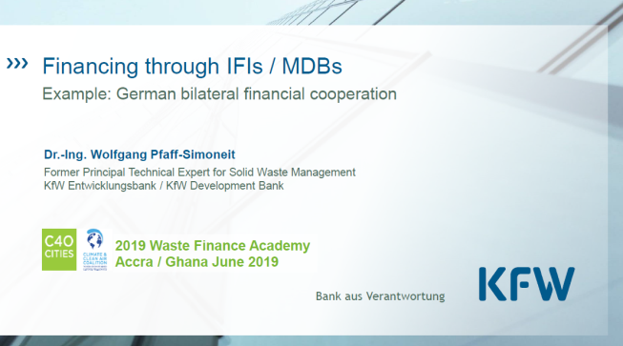
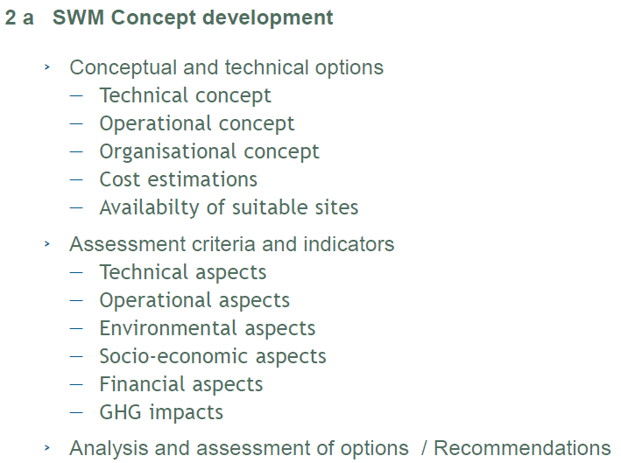
A FUNDER’s PERSPECTIVE
Know your IW or SW system if you are looking for fundings for development

Slide 22
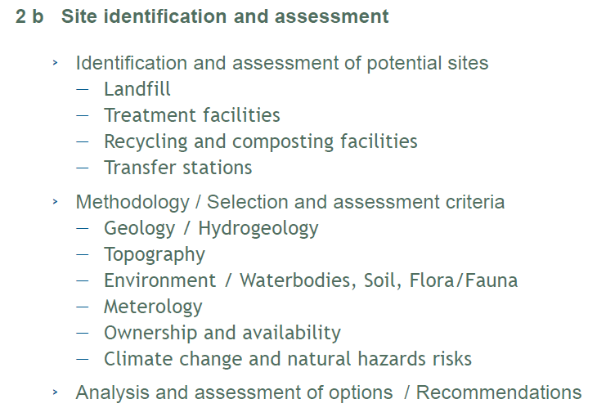
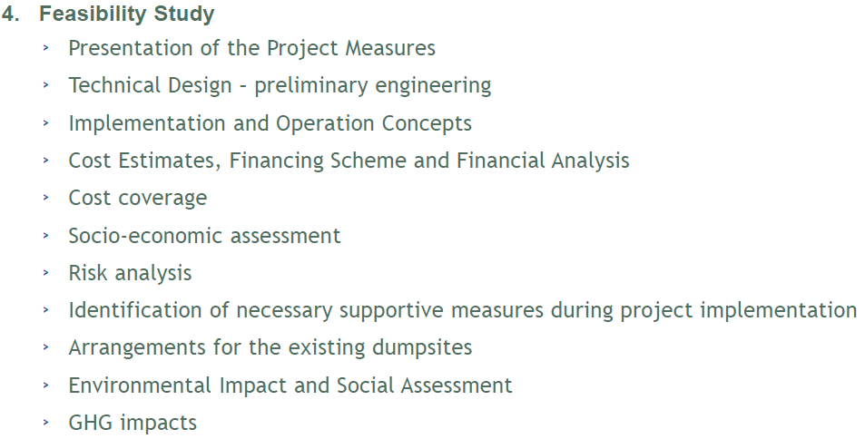
A FUNDER’s PERSPECTIVE
Know your IW or SW system if you are looking for fundings

Slide 23
the waste flow analysis
as a tool to know your system
And
define the cost of SWM
describe the context and the existing swm system

Slide 24
the essence of the waste flow analysis: follow the value
This schematic shows all the main recovery flows from waste that is theoretically possible to set in place:
1
OTHER
OTHER
MUNICIPAL and SIMILAR WASTE
RECOVERY of DRY FRACTIONS
2
Materials recovered from SC of selected dry fractions (need infrastructural and industrial chain either domestically or through export of recyclables).
Compost of high quality can be recovered with the appropriate technologies from SC of food and green waste.
Energy and compost can be recovered by the anaerobic digestion of food and garden waste.
Energy can be recovered from the thermal treatment of residual waste in the form of electricity and heat.
Waste that cannot be recovered is disposed in landfills: energy can be recovered from biodegradable waste, by burning biogas in dedicated engines.
COMPOSTING of FOOD WASTE from SEGREGATED COLLECTION
COMPOST to MARKET
3
ANAEROBIC DIGESTION of FOOD WASTE with ENERGY RECOVERY from BIOGAS
DIGESTATE to MARKET
4
THERMAL TREATMENT of RESIDUAL WASTE with ENERGY RECOVERY
5
LANDFILLING of RESIDUAL WASTE with ENERGY RECOVERY from BIOGAS
The diagrams used in these figures were drawn with the software WRATE, originally developed for LCA for waste management by the Environmental Agency for England and Wales http://www.wrate-lca.co.uk/

Slide 25
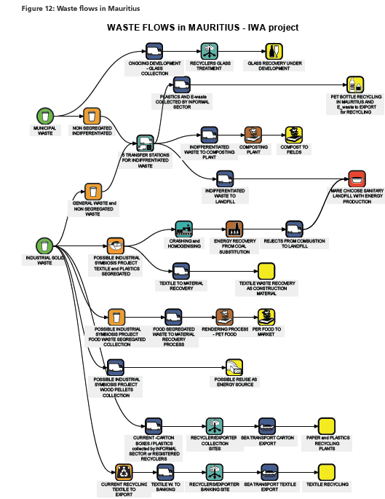

Slide 26
WASTE FLOWS of a schematic INTEGRATED SWM system
RESIDUAL WASTE to LANDFILL
RESIDUAL WASTE to SANITARY LANDFILL with BIOGAS and ENERGY RECOVERY
WET FRACTION from MBT to LANDFILL
FERROUS
REPROCESSING
FE from MBT to RECYCLING
RESIDUAL WASTE from “door to door”
RESIDUAL waste to TREATMENT
PRE-TREATMENT of RESIDUAL WASTE
DRY FRACTION from MBT to ENERGY RECOVERY
to FE RECOVERY
FERROUS
REPROCESSING
Understand and describe the SWM system by activities
RESIDUAL WASTE from STREET CONTAINERS
RESIDUAL WASTE to THERMAL TREATMENT
THERMAL TREATMENT with ENERGY RECOVERY
FLY ASHES to LANDFILL
HAZARDOUS WASTE to LANDFILL
BOTTOM ASH to RECOVERY
OTHER
HOUSEHOLD WASTE
RECOVERY of BOTTOM ASH
SANITARY LANDFILL with ENERGY RECOVERY
SORTING PLANT for DRY FRACTIONS RECYCLABLES
REJECTS from SORTING to LANDFILL
SEGREGATED COLLECTION of DRY FRACTIONS
DRY FRACTIONS
to TRANSFER STATION
PAPER
REPROCESSING
TRANSFER STATION
to REPROCESSING
INTERNATIONAL TRANSPORT of RECYLABLES
REJECTS from SORTING to ENERGY RECOVERY
COLLECTION CENTRES
PLASTIC
REPROCESSING
OTHER FRACTIONS to TRANSFER STATION
II° SORTING PLANT for PLASTICS RECYCLABLE
COMMERCIAL / BUSINESS WASTE
PRIVATE CITIZENS to COLLECTION CENTRES
GLASS
REPROCESSING
to REPROCESSING
SEGREGATED COLLECTION of FOOD WASTE
to COMPOSTING or ANAEROBIC DIGESTION
COMPOST to MARKET
COMPOSTING PLANT
SANITARY LANDFILL with ENERGY RECOVERY
ORGANIC REJECTS to LANDFILL
ANAEROBIC DIGESTION PLANT
with ENERGY RECOVERY
from BIOGAS
DIGESTATE to MARKET
GREEN WASTE SEGREGATED COLLECTION from PUBLIC PARKS
to COMPOSTING or ANAEROBIC DIGESTION

Slide 27
How to set up a separated SWM public budget

Slide 28
Need a comprehensive vision of SWM to account for the true costs and revenues
Industrial Waste Generators and Service Providers around the world often do not account for the entire cost of SWM and do NOT keep a specific and separated SWM accounting system.
The following could be a common situation:
Local Authorities own collection vehicles, hire drivers and collection personnel and keep a record only of these expenses;
National’s finance departments collect and record taxes and service tariffs paid by some waste generators: households; industries; commercial venues; …
the City’s public work department or the Local Authorities or privates firms may be in charge of running transfer stations, and know only those costs;
the informal sectors collects some waste fractions and finds a market for some recyclables;
private owners manage composting facilities and keep their own budget, which is included in the SWM budget as a (one number) gate-fee without any analysis of cost effectiveness;
National government issues feed-in tariffs to buy energy from landfills at a price that Local Authorities do not control but often do not even know.

Slide 29
In this fragmented financial context, decisions to spend money to change a portion of the SWM system are made by administrators in isolation and it is impossible to assess these expenses contribution toward an effective SWM.
Investors, both public and private, are unable to assess the profitability of change: they might end up walking away from an investment or they might support the introduction of a specific equipment or technology that worked somewhere else but that nobody in the City / National Government is able to assess for its effect on that specific SWM system and community.
In South Africa “The National Waste Management Strategy (2011) recognises the importance of full cost accounting as the foundation of financial sustainability, which is critical in the delivery of effective and efficient waste services and in the promotion of waste minimisation, reuse, recycling and recovery”.

Slide 30
Full Cost Accounting includes:
Up-front costs comprise the initial investments and expenses necessary to manage SWM services: land acquisition; approval process; construction and modification of facilities; plants and infrastructure; support services provided by other local government departments;
Operating costs are the expenses of SWM on a daily basis;
Back-end costs include expenditures to properly wrap up operations and take proper care of landfills and other SWM facilities at the end of their useful lives. Cash outlays for back-end costs are not made until after the useful life of the facility has ended, those costs are said to be “accruing” (‘accumulating’) during the active life of the facility. They include:
costs of closure and long-term care
decommissioning of buildings and equipment
post-operating of landfills
retirement and post-employment health benefits for employees.

Slide 31
Whose costs should LAs include in the overall SWM system
The Actors sustaining the costs to be included in the SWM budget :
the City and the Local Authorities providing the SWM service and related services, such as accounting, billing, SWM design;
public or private sector providers of SWM activities which should – by legislation - be provided by the Local Authority
citizens’ self-providing expenses, such as privately owned containers, when these should be part of the provided public service
the informal sector providing services which are part of an effective SWM’s objectives and targets, such as recycling
volunteer and nongovernmental groups performing actions which are part of the regular SWM activities: such as information campaigns agreed with the local administration.

Slide 32
Investment costs
+
Large maintenance costs
+
Cost of the use of capital
FINANCING GAP
International public transfers
Voluntary contributions
Repayable finance:
commercial loans, bonds, equity, concessionary loans
Overheads
Tranfers
Operating and maintenance
Taxes
Materials and energy recovery from waste
SWM service tariffs
costs
revenues

Slide 33
Types of costs
The types of costs to be reported on an annual basis are:
Direct costs. Operating and maintenance are the recurrent expenses to provide SWM services. Maintenance costs are the routine expenditures needed to keep the system running at design performance, but don’t include major repairs or renewals.
Overhead: costs common across SWM activities such as accounting, billing (allocated according to partitioning principles, such as percentage of labour cost).
Capital Investments /Amortization: must be accounted to finance infrastructure expansion, rehabilitation, capital funding to ensure long-term sustainability of service:
cost of designing the alternative scenarios and the needed investment, this phase might require the support of consultants external to the administration
administrative costs of the approval process
actual cost of the investment
cost of the use of the capital
reserves set aside for future investments.
Large facilities and plants maintenance costs

Slide 34
The introduction of new facilities and plants requires high expenses, both in the design and the infrastructure building phases and there is often going to be a gap “between the capital expenditure requirement and the fund availability with the city governments.”
WHEN the structure of cost is not completely understood and funding sources are not adequately secured, the funding gap “has the potential to result in delays to or abandonment” of the project. (CDIA, KPMG. 2010).
Cash flow
Construction phase
major maintenence
Estimated costs and budget allocated
design phase
approval phase
O&M expenses
time of SWM project’s development and use of infrastructure
cash out flow during the different phase of a SWM project requiring the construction of facilities and plants

Slide 35
Types of revenues to be reported on an annual basis are:
A .Service tariffs contributed by service users to service providers; collected from different waste generators (households, restaurants, industrial premises...).
B. Materials and energy recovery from waste: generated from specific schemes, facilities and plants, they may NOT be available in ineffective SWM system. Recovery of materials from waste usually is a net cost of SWM, because the revenues from the sales of recyclable do not cover the cost of segregated collection, transport and the operation of the sorting and re-processing plants.
C. Taxes refer to funds originating from domestic taxes that are transferred to the SWM sector from any level of government – national, regional or local.
D. Transfers refers to funds from national government; such funds would typically be provided as subsidies for capital investment or operations.

Slide 36
Types of revenues to be reported on an annual basis are (contd.):
External sources may include the following:
E. repayable finance: includes bank loans, commercial finance, microfinance, equity; these funds are provided by investors with the expectation that they would be repaid and would earn a rate of return on the capital invested. Bonds are sold on the market to investors; bond issuers may include cities (municipal bonds) or public and private companies (corporate bonds). Concessionary grants are loans from donors that would include a grant or transfer element in the form of an interest rate below market rate, or a grace period.
F. International public transfers: voluntary donations (or grants) from public donors and multilateral agencies that come from other countries.
G. Voluntary contributions (or grants) from international and national non-governmental donors including from charitable foundations, non-governmental organizations (NGOs), civil society organizations and individuals (remittances).

Slide 37
Organise the cost accounting system to support decision making
The overall goal of a SWM costs/revenues accounting is not to burden the administration with a new tasks but to ensure that the information and data generated provide an understanding of how the SWM system is operated so as to control its effectiveness and strengthen policy-making.
“Different decisions often require different cost data” (UN-Glass, WHO. 2016).
The main types of cost information needed by policy-makers in SWM are:
the total cost of the current SWM system, the proportion covered by service tariffs and if the tariffs collection should and could be increased
how are the costs distributed in the SWM service and where inefficiencies occur: useful indicators could be the “cost per activity per user” or “cost per activity per tonnes of waste collected”
how to finance the step-by-step evolution of an ineffective or scarcely integrated SWM system and what external funding sources could be activated.

Slide 38
To support decision-makers and SWM managers, the accounting office could organise the voices of cost and revenues in two ways, providing two types of tables:
A Table in which costs and revenues are associated to each activity of SWM:
collection
transport
transfer station
recycling
composting
anaerobic digestion
landfilling
thermal treatment
pre-treatment of residual waste

Slide 39
WASTE FLOWS of a schematic INTEGRATED SWM system
RESIDUAL WASTE to LANDFILL
RESIDUAL WASTE to SANITARY LANDFILL with BIOGAS and ENERGY RECOVERY
WET FRACTION from MBT to LANDFILL
FERROUS
REPROCESSING
FE from MBT to RECYCLING
RESIDUAL WASTE from “door to door”
RESIDUAL waste to TREATMENT
PRE-TREATMENT of RESIDUAL WASTE
DRY FRACTION from MBT to ENERGY RECOVERY
to FE RECOVERY
FERROUS
REPROCESSING
Understand and describe the SWM system by activities
RESIDUAL WASTE from STREET CONTAINERS
RESIDUAL WASTE to THERMAL TREATMENT
THERMAL TREATMENT with ENERGY RECOVERY
FLY ASHES to LANDFILL
HAZARDOUS WASTE to LANDFILL
BOTTOM ASH to RECOVERY
OTHER
HOUSEHOLD WASTE
RECOVERY of BOTTOM ASH
SANITARY LANDFILL with ENERGY RECOVERY
SORTING PLANT for DRY FRACTIONS RECYCLABLES
REJECTS from SORTING to LANDFILL
SEGREGATED COLLECTION of DRY FRACTIONS
DRY FRACTIONS
to TRANSFER STATION
PAPER
REPROCESSING
TRANSFER STATION
to REPROCESSING
INTERNATIONAL TRANSPORT of RECYLABLES
REJECTS from SORTING to ENERGY RECOVERY
COLLECTION CENTRES
PLASTIC
REPROCESSING
OTHER FRACTIONS to TRANSFER STATION
II° SORTING PLANT for PLASTICS RECYCLABLE
COMMERCIAL / BUSINESS WASTE
PRIVATE CITIZENS to COLLECTION CENTRES
GLASS
REPROCESSING
to REPROCESSING
SEGREGATED COLLECTION of FOOD WASTE
to COMPOSTING or ANAEROBIC DIGESTION
COMPOST to MARKET
COMPOSTING PLANT
SANITARY LANDFILL with ENERGY RECOVERY
ORGANIC REJECTS to LANDFILL
ANAEROBIC DIGESTION PLANT
with ENERGY RECOVERY
from BIOGAS
DIGESTATE to MARKET
GREEN WASTE SEGREGATED COLLECTION from PUBLIC PARKS
to COMPOSTING or ANAEROBIC DIGESTION

Slide 40
Cost per activity | COLLECTION | TRASPORT 1ST dstnt | TRASPORT FURTHER destinations | TRASFER STATION | SORTING PLANT | COMPOSTING | ANAEROBIC DIGESTION | LANDFILL | PRE-TREATMENT | TOTAL per COST TYPE
Operating & maintenance
fuels and goods
personnel
cleaning
services from private providers
rentals
Overheads
budgeting and administration
billing
information campaigns
Investment / Capital
DEPRECIATION of new fixed assets acquired by investment (building, plants, equipment)
DEPRECIATION of pre-existing fixed assets (building, plants, equipment)
Investmentand capital cost
Large capital maintenance cost
Annual RESERVES for future investments
Revenues: sales of materials |  |  |  |  | X | X | X
Revenues: sales of energy |  |  |  |  |  |  | X | X
TOTAL per ACTIVITY

Slide 41
The criteria to set up an effective SWM accounting system
keep SWM accounting separated from other services, other expenses, other service tariffs and other taxes waste generators and citizens might assume that SWM costs virtually nothing and does not depend on the amounts they generate;
Designate a dedicated Unit /Office in charge of keeping the accounting and collecting data from other Offices;
define by legislation the sources of waste to be included in the service provided by the Local Authority and the criteria for billing: households; commercial, business, industrial, …;
organise the cost and revenues data in accordance with the description given by the waste flow analysis of the existing SWM system: this gives an accurate and complete list of SWM activities and sub-services provided;
estimate the full cost of alternative SWM scenarios on the basis of their waste flow analysis, to assess their financial feasibility
use techniques such as depreciation and amortization which produce a more accurate picture of the costs of SWM current and future systems, without the distortions associated to focusing solely on a given year’s cash expenditures.

Slide 42
Financial analysis
An essential element that is regularly reviewed is the structuring of the project, particularly if that structuring involves a private-sector operator who helps to mitigate some of the project’s risk and operational costs.
Primary challenges :
Defining the status of a project’s development : concept; initial engineering or financial feasibility;
Articulating, in language focused on execution of the project, the financial feasibility of a program, regardless of the ultimate sources of capital selected;
Accessing finance from charitable foundations, donors and other aid agencies to develop projects and demonstrate financial feasibility;
Establishing creditworthiness, financial responsibility, and integrity of municipality as a lead agency (regardless of intended status as borrower or partner in a public-private partnership);
Understanding instruments and tools available for cities seeking to finance municipal SWM initiatives.

Slide 43
analyse the governance framework and assess the need to modify legislation
The main objectives and the effective operation of a SWM system – including the management of IW - can be guaranteed only within an appropriate institutional and administrative framework.
the relevant governance factors
actors move within a clear and stable institutional and legislative framework; continuity is ensured beyond political terms of office
there is a relatively high level of trust in public institution which operate transparently:
the involvement of the public sector in SWM is high
the cost of the current system and of financing opportunities for SWM evolution at national and city level is clearly defined and updated
Both at the National and City levels, dedicated Waste Offices are operating:
a dedicated and well-resourced Environmental Agency is in charge of ensuring controls and monitoring of health and environmental impacts, and regulations enforcement
Capacity building for institutional and administrative personnel: Universities and research centres address the SWM research

Slide 44
A FUNDER’s PERSPECTIVE

