Slide 1
Relevance of the cost structure in Industrial Waste Management
Ministry of Industrial Development, SMEs and Cooperatives
Inception Workshop on
Industrial Waste Management: Cost Structure Review
Dr. S. Tunesi, International Consultant UNIDO
Prof. D. Surroop, National Consultant UNIDO
4 February 2020

Slide 2
The goals of this project:
Analyse the structure of the costs associated to managing Industrial Waste
Analyse the structure of the costs borne by the public sector in managing Industrial (and Municipal) waste because often the two managements overlap
Increase in Mauritius the effectiveness of IW management by clarifying the cost of different management alternatives; recycling locally or export; industrial symbiosys; composting, energy recovery;….
Understand if and what role that the Public Sector can play in increasing IW management effectiveness: e.g. incentives and disincentives to reduce landfilling

Slide 3
Industrial waste and how they fit in a larger
waste management and
health and environmental protection
picture

Slide 4
ClassificaTion of waste
HOUSEHOLD
classified by origin
Municipal
COMMERCE and BUSINESS:
can be declared ‘similar’ and managed together with household
Industry
Agriculture
Medical
…..
similar waste | Waste which in nature and composition is similar to household waste, even if from other origins, and it can thus be collected, disposed of and treated together with household waste.
Non Hazardous
classified by hazard
Hazardous

Slide 5
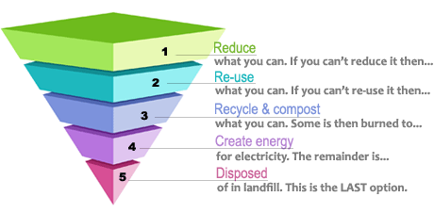
The waste hierarchy
(a) prevention
(b) preparing for re-use
(c) recycling
(d) other recovery, e.g. energy recovery
(e) disposal

Slide 6
relationships between waste generation and management and the world of production and consumption
1. INPUT of RESOURCES and ENERGY
Construction; Operation; Maintenance; Dismantling
Consumption of electrical energy, of gas for heating and transport.
Fertilisers, soil conditioners for agriculture
  Recycling of materials in industries, the building sector, roads.
PREVENTION
THERMAL TREATMENTS energy recovery
WASTES
arisings, composition
COLLECTION
containers, bags, cards
TRANSPORT
pre-TREATMENT of residual waste (MBT)
3. OUTPUT of RESORCES and ENERGY from the WM SISTEM
LANDFILLS hazardous W non–hazardous
INTERMEDIATE PLANTS:
selection of dry fractions
Home
Composting
MATERIAL RECOVERY
ANAEROBIC DIGESTION, COMPOSTING
To improve the social, financial and environmental effectiveness of WM
the question becomes:
how to optimise these types of recovery from all types of waste ?
And knowing the costs is an essential element
2. EMISSIONS and WASTES to environment

Slide 7
IW management can be difficult.
Waste streams are complicated to measure, track, and evaluate.
In general, we have a sense that recycling is good—and that we should be doing more to increase our sustainability efforts.
But do you know exactly how good recycling or alternative activities can be for the environment and for your business?
And here is where the relevance of knowing the costs comes in
Defining the cost of IW management activities gives a relevant contribution to knowing how to efficiently manage IW and reducing the impact on the environment.

Slide 8
difference and relationship between Costs and tariffs
Industrial waste can be managed by the private sector directly dealing with the market at a direct cost.
Or IW can be managed by the public sector by issuing a tax / tariff that covers the costs of: collection; managing transfer stations; managing landfill; cost of issuing tariffs,……..
It is the national legislation that defines what is the service provision structure: usually IW are managed through market.

Slide 9
difference and relationship between Costs and tariffs
But the Public Sector is involved in IW management in many ways:
If the Public Sector spends money without covering the cost the infrastructural system it will never develop an overall effective solid waste management system
the incentive / taxes systems defined by the Public influences directly the cost of managing industrial waste
the externalities associated to the generation and management of IW fall on the environment and public health: the landfill space is taken up and land that could have different uses is used up
this is why this UNIDO project is made of 2 Questionnaires which are the two faces of the same medal:
the project aims at defining the visible costs borne by the Private Actors and the often invisible costs/externalities borne by the Public

Slide 10
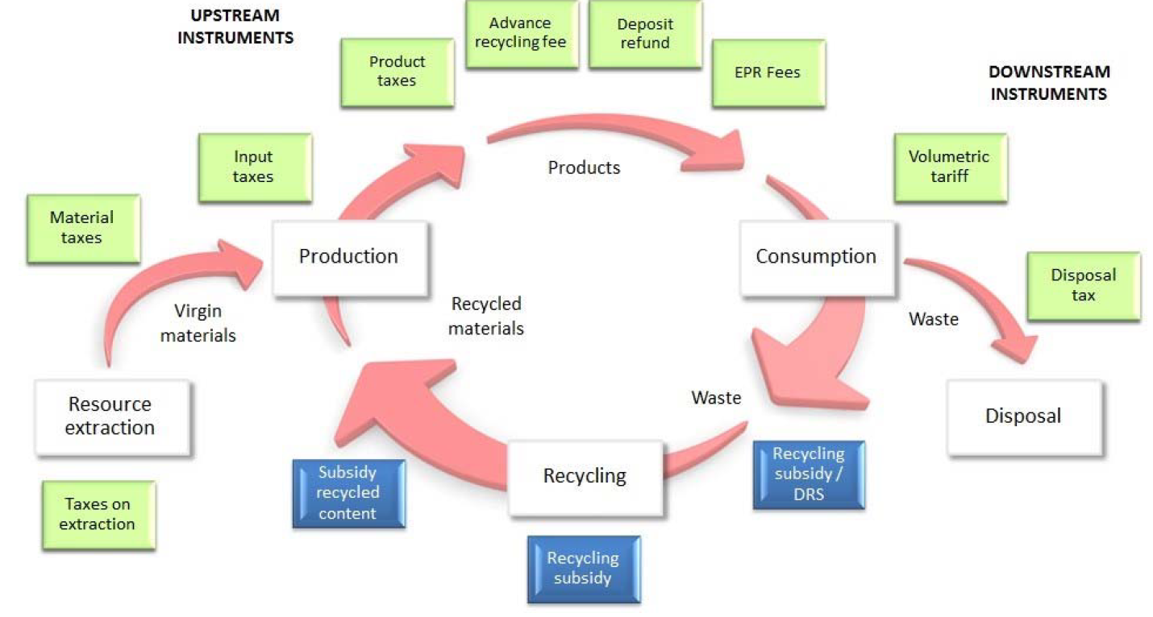
“Economic instruments are used to change behaviour by setting the level of the tax /subsidy at or near the level of the extern cost.
Under pricing creates the wrong set of incentive and undermine waste minimisation efforts and the Polluter pays principle → disposal in landfill is perceived as the least costly and thus more attractive.”
Range of economic instruments
From “South Africa NWMS”

Slide 11
The relevance of economic instruments to improve WM effectivness
“Creating financial incentives and disincentives in respect to WM behaviour by applying WM charges is understood worldwide to be the most effective way of reducing waste and improving levels of reuse, recycling and recovery.
All Actors of SWM must be aware that “the drive toward recycling comes at a cost and it is ultimately borne by the consumers as taxes are proposed for the disposal of waste going to landfill and levies are imposed by Government or industry to the cost of production.”
At the interface between industries generation of waste and the public cost of dealing with it, there is the role of EPR schemes: in which industries and distributors assume the responsibility for the waste they generate.
But EPR also comes at a cost for the consumer: industries are not willing to bear the cost of managing the waste they create.
“South Africa State of Waste – draft 2018”

Slide 12
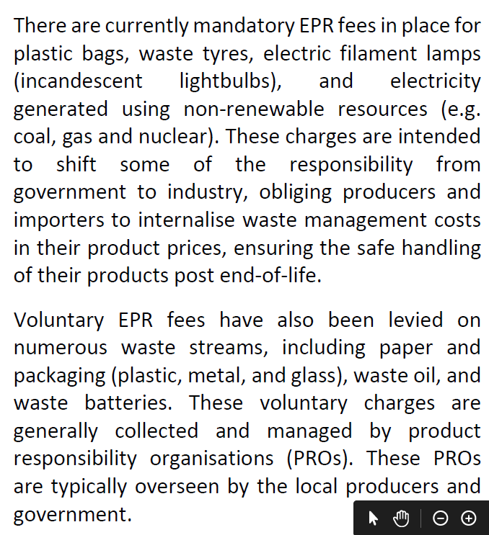
From “South Africa NWMS”

Slide 13
Both Solid Waste Generators – such as Industries - and Service Providers - such as Local Authorities /Governments - need a method to calculate Costs and Tariffs and define Incentives /disincentives
Know your Solid Waste Management system:
  Industrial process and waste generation (IWA project in 2016)
  The overall SWM system
calculate cost for each activity of management
To define tariffs → Understand the overlap between private and public activities
To define incentives /disincentives → must have clear environmental / recovery from waste objectives

Slide 14
Know your Solid Waste Management system:
The Industrial process and waste generation
describing your system is the first step to understand how to control and improve it.

Slide 15

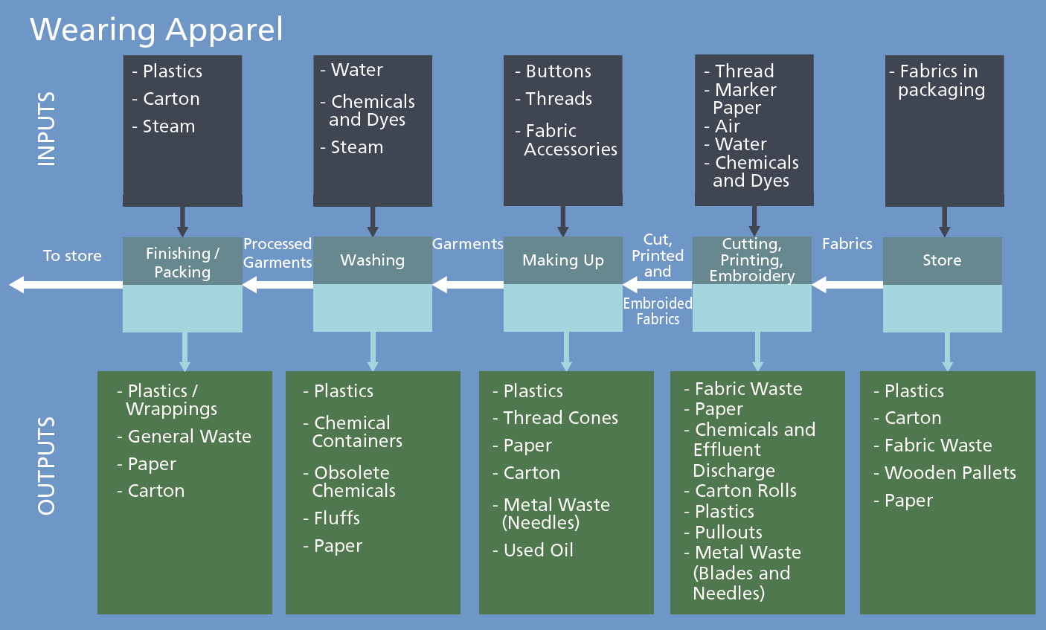

Slide 16
Know your Solid Waste Management system:
The overall SWM system
describing your system is the first step to understand how to control and improve it.

Slide 17
Waste sources and amounts
waste characteristics - existing and forecast
waste amounts generated yearly per each relevant waste source households commerce and restaurants green waste from public and private parks industries hospitals and health structures ….. | tonnes / year
hazardous waste amounts generated | tonnes / year
municipal waste generated per capita | tonnes / year/ person
composition of the waste Waste characterization is an expensive activity; oftentimes reliable and updated data are not available. Hypothesis can be formulated on the basis of composition available for similar socio-economic situations. | Paper Plastics Food waste Metal cans Textile WEEE C&D …

Slide 18
residual waste is what remains after segregated collection
Disposal in landfill
RESIDUAL WASTE to LANDFILL
RESIDUAL WASTE to SANITARY LANDFILL
WET FRACTION from MBT to LANDFILL
A complete vision must be adopted to decide which WM activities to incentivise / disincentivise
PRE-treatment of residual W
FERROUS
REPROCESSING
FE from MBT to RECYCLING
Thermal Treatment of residual W
with ENERGY RECOVERY
RESIDUAL WASTE from “door to door”
RESIDUAL waste to TREATMENT
PRE-TREATMENT of RESIDUAL WASTE
DRY FRACTION from MBT to ENERGY RECOVERY
to FE RECOVERY
FERROUS
REPROCESSING
RESIDUAL WASTE from PROXIMITY CONTAINERS
RESIDUAL WASTE to THERMAL TREATMENT
THERMAL TREATMENT with ENERGY RECOVERY
FLY ASHES to LANDFILL
HAZARDOUS WASTE to LANDFILL
BOTTOM ASH to RECOVERY
OTHER
waste type, amount and composition
HOUSEHOLD WASTE
RECOVERY of BOTTOM ASH
intermediate sorting plants from SC
SORTING PLANT for DRY FRACTIONS RECYCLABLES
SANITARY LANDFILL
organisation of collection
SEGREGATED COLLECTION of DRY FRACTIONS
DRY FRACTIONS
to TRANSFER STATION
REJECTS from SORTING to LANDFILL
PAPER
REPROCESSING
international transport of recyclables
Segregated Collection: to separate waste fractions one by one
TRANSFER STATION
INTERNATIONAL TRANSPORT of RECYLABLES
transport
REJECTS from SORTING to ENERGY RECOVERY
COLLECTION CENTRE
PLASTIC
REPROCESSING
PRIVATE CITIZENS to COLLECTION CENTRES
OTHER FRACTIONS to TRANSFER STATION
II° SORTING PLANT
for PLASTICS RECYCLABLE
COMMERCIAL / BUSINESS WASTE
GLASS
REPROCESSING
recovery from organic waste: Compost and energy
recovery of materials
SEGREGATED COLLECTION of FOOD WASTE
to COMPOSTING or ANAEROBIC DIGESTION
COMPOST to MARKET
COLLECTION
COMPOSTING PLANT
SANITARY LANDFILL
ORGANIC REJECTS to LANDFILL
ANAEROBIC DIGESTION PLANT
with ENERGY RECOVERY
from BIOGAS
DIGESTATE to MARKET
GREEN WASTE SEGREGATED COLLECTION from PUBLIC PARKS
to COMPOSTING or ANAEROBIC DIGESTION

Slide 19
waste sources to be included in SWM design
Account for all sources and amounts: if some streams are excluded from the knowledge base or if the legislation does not set regulations for them, the need for collection and treatment capacity will be underestimated.
Waste legislations often maintains a separation in the responsibilities for SWM: with the public managing municipal waste and the private sector managing production waste.
But the knowledge of the many sources and the quantification of the amounts generated remains the first requisite of any planning effort: even if these waste are not part of the public planning effort they must be part of the knowledge.
waste types : need to be collected separately and managed by specific treatments, and may require specific legislation. A waste source may generate several types of waste:
household waste and similar waste
packaging
WEEE: waste of electric and electronic equipment
tyres
end of life vehicles
batteries and accumulators
construction and demolition

Slide 20
Know your system to be able to choose what type of infrastructure to develop
equipment – facilities – plants that form an effective SWM system | Material recovery | Energy Recovery
Centres for the preparation for reuse of selected waste types | X
Collection Containers for residual waste and recyclable fractions
Vehicles for collection
Transfer stations
Collection centres | X
SC Cleaning and Sorting plants and re-processing plants | X
Composting plants | X
Anaerobic Digestion plants | X | X
Thermal Treatment plants (mainly incineration, and also gasification) | X | X
slags from thermal treatment can be recovered as road aggregates | X
fly ash could be recovered or must be disposed of in hazardous waste landfills | X
residual waste can be pre-treated by mechanical operations (crushing and sieving) to reduce the volume going to landfill and separate two waste streams. mechanical operations are pre-treatments not a final treatment for residual waste.
the biological process of partial stabilisation following a mechanical pre-treatment
landfills for non hazardous and hazardous waste
Engines and plants for the recovery of biogas from landfills |  | X

Slide 21
BEFORE GETTING STARTED ON COSTS
clarify the roles and responsibilities of public and private actors
Analyze the roles and responsibilities of both public and private actors:
who is in charge of collection:
  if Local Authorities are in charge, what is their budget? Is collection cost covered by service tariffs / taxes?
  if private enterprises are performing waste collection, what is the contractual arrangement with the institution billing for service tariffs/taxes?
  Who is managing / at what cost the other plants ?
The actors – public or private - performing the several SWM activities must be identified:
who operates recycling facilities?
who operates the facilities and treatment plants?
Who operates landfills ?

Slide 22
BEFORE GETTING STARTED ON COSTS
Understand the functions of the different actors in a SWM system :
SWM policy-makers, designers and regulators contribute to the writing of the SWM City Action Plan, its implementation, and to the enforcement of legislation;
the interested and/or affected sectors of the civil society have the right to discuss the existing SWM situation and the proposed alternative solutions, including health and environmental impacts, and cost and tariffs of service;
services providers perform SWM activities, such as waste collection, or manage relevant facilities and plants;
industrial actors produce the objects that then become waste.
Knowledge of costs
EPR
Knowledge of costs
Knowledge of costs
EPR

Slide 23
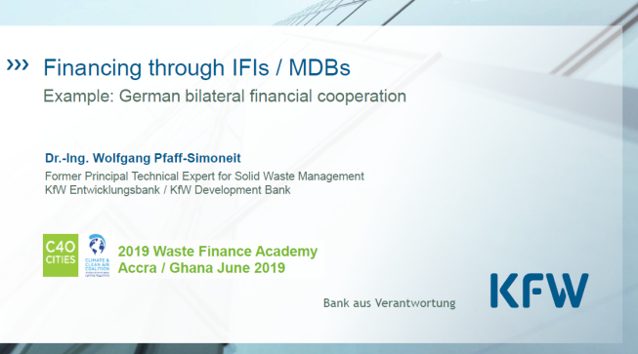
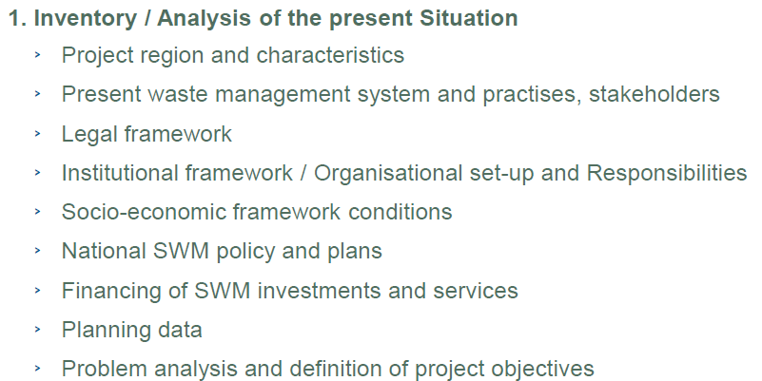
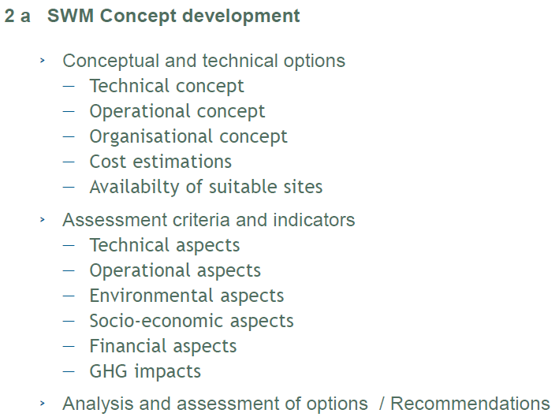
A FUNDER’s PERSPECTIVE
Know your IW or SW system if you are looking for fundings for development

Slide 24

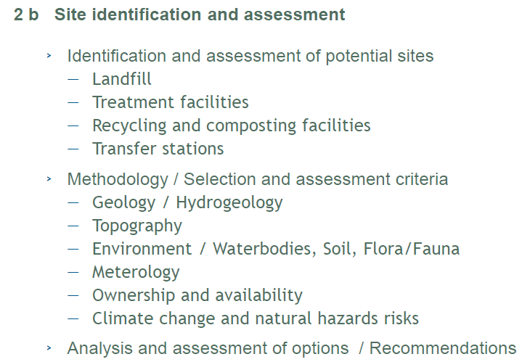
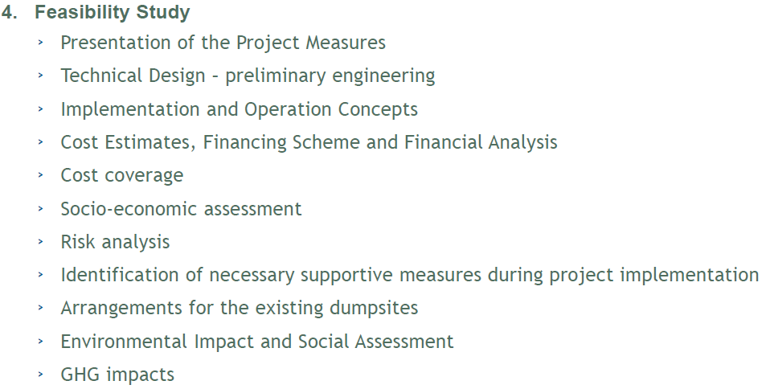
A FUNDER’s PERSPECTIVE
Know your IW or SW system if you are looking for fundings

Slide 25
the waste flow analysis
as a tool to know your system
And
define the cost of SWM

Slide 26
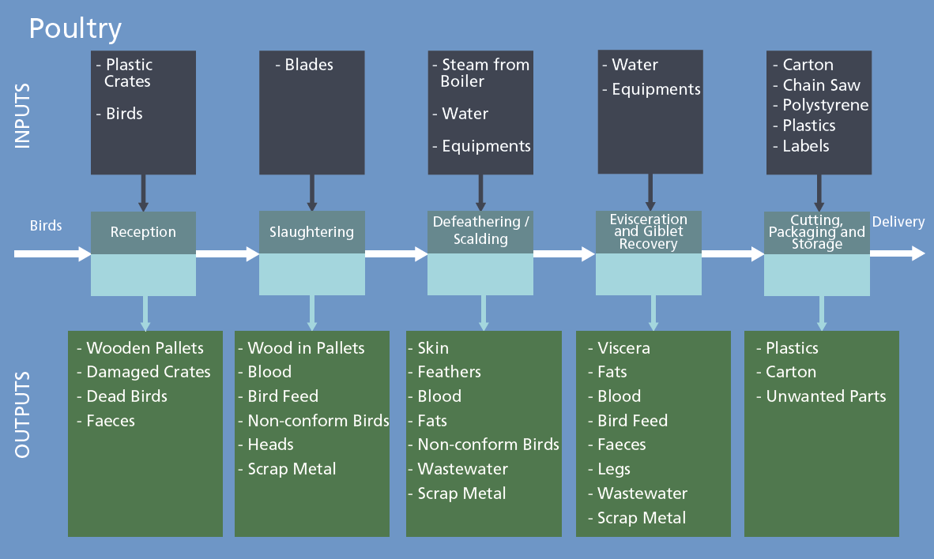
Industrial and Waste Flow Process for the poultry industry

Slide 27
WASTE FLOWS of a schematic INTEGRATED SWM system
RESIDUAL WASTE to LANDFILL
RESIDUAL WASTE to SANITARY LANDFILL with BIOGAS and ENERGY RECOVERY
WET FRACTION from MBT to LANDFILL
FERROUS
REPROCESSING
FE from MBT to RECYCLING
RESIDUAL WASTE from “door to door”
RESIDUAL waste to TREATMENT
PRE-TREATMENT of RESIDUAL WASTE
DRY FRACTION from MBT to ENERGY RECOVERY
to FE RECOVERY
FERROUS
REPROCESSING
Understand and describe the SWM system by activities
RESIDUAL WASTE from STREET CONTAINERS
RESIDUAL WASTE to THERMAL TREATMENT
THERMAL TREATMENT with ENERGY RECOVERY
FLY ASHES to LANDFILL
HAZARDOUS WASTE to LANDFILL
BOTTOM ASH to RECOVERY
OTHER
HOUSEHOLD WASTE
RECOVERY of BOTTOM ASH
SANITARY LANDFILL with ENERGY RECOVERY
SORTING PLANT for DRY FRACTIONS RECYCLABLES
REJECTS from SORTING to LANDFILL
SEGREGATED COLLECTION of DRY FRACTIONS
DRY FRACTIONS
to TRANSFER STATION
PAPER
REPROCESSING
TRANSFER STATION
to REPROCESSING
INTERNATIONAL TRANSPORT of RECYLABLES
REJECTS from SORTING to ENERGY RECOVERY
COLLECTION CENTRES
PLASTIC
REPROCESSING
OTHER FRACTIONS to TRANSFER STATION
II° SORTING PLANT for PLASTICS RECYCLABLE
COMMERCIAL / BUSINESS WASTE
PRIVATE CITIZENS to COLLECTION CENTRES
GLASS
REPROCESSING
to REPROCESSING
SEGREGATED COLLECTION of FOOD WASTE
to COMPOSTING or ANAEROBIC DIGESTION
COMPOST to MARKET
COMPOSTING PLANT
SANITARY LANDFILL with ENERGY RECOVERY
ORGANIC REJECTS to LANDFILL
ANAEROBIC DIGESTION PLANT
with ENERGY RECOVERY
from BIOGAS
DIGESTATE to MARKET
GREEN WASTE SEGREGATED COLLECTION from PUBLIC PARKS
to COMPOSTING or ANAEROBIC DIGESTION

Slide 28
the SWM system description must be complete and detailed
Having to follow the waste flows forces to quantify capacity gaps (tonnes/year) for each sub-service: i.e. the plants and capacity which would be required if all waste were to be collected and to divert waste away from landfilling (or open burning) towards materials and energy recovery.
When the existing system is compared with the description of an integrated SWM system, the waste flow analysis allows understanding which elements (segregated collection, recycling plants …) are missing and what elements could be gradually introduced to begin the evolution of the system.
If a SWM system is described incompletely, for instance calculating the capacity need for landfills by not including the waste currently un-collected, the result is an underestimate of the capacity needs for new facilities and plants.
An incomplete system also underestimates the cost required to finance its evolution.

Slide 29
the essence of the waste flow analysis for industrial processes or public WM: follow the value
1
OTHER
Recovery from waste :
OTHER
MUNICIPAL and SIMILAR WASTE
RECOVERY of DRY FRACTIONS
2
Materials recovered from SC of selected dry fractions (need infrastructural and industrial chain either domestically or through export of recyclables).
Compost of high quality can be recovered with the appropriate technologies from SC of food and green waste.
Energy and compost can be recovered by the anaerobic digestion of food and garden waste.
Energy can be recovered from the thermal treatment of residual waste in the form of electricity and heat.
Waste that cannot be recovered is disposed in landfills: energy can be recovered from biodegradable waste, by burning biogas in dedicated engines.
COMPOSTING of FOOD WASTE from SEGREGATED COLLECTION
COMPOST to MARKET
3
ANAEROBIC DIGESTION of FOOD WASTE with ENERGY RECOVERY from BIOGAS
DIGESTATE to MARKET
4
THERMAL TREATMENT of RESIDUAL WASTE with ENERGY RECOVERY
5
LANDFILLING of RESIDUAL WASTE with ENERGY RECOVERY from BIOGAS
The diagrams used in these figures were drawn with the software WRATE, originally developed for LCA for waste management by the Environmental Agency for England and Wales http://www.wrate-lca.co.uk/

Slide 30
example: the materials recovery chain (simplified)
to II° PLASTICS SORTING
5
To REPROCESSING
3
TRANSPORT to
SORTING PLANTS
4
PLANTS for II° SORTING of PLASTICS
PLASTICS REPROCESSING and MARKET
PLASTIC or PAPER BAGS for PAPER or PLASTICS SEGREGATED COLLECTION
PAPER REPROCESSING and MARKET
7
VEHICLES collecting SEGREGATED FRACTIONS
REPROCESSING
1
TRANSFER STATION where waste is banked for a more efficient transport
CLEANING and
SORTING PLANT
TRANSPORT to
BINS for “door to door' collection: suitable for ANY FRACTION
PLANTS
GLASS REPROCESSING and MARKET
INFORMAL COLLECTION
Non-FERROUS REPROCESSING and MARKET
LARGE STREET CONTAINERS can be used for the SEGREGATED COLLECTION of ANY FRACTION
MUNICIPAL WASTE
and SIMILAR
6
WASTE
FRACTION
LANDFILL
SORTING REJECTS
2
TRANSPORT to REPROCESSING PLANTS
to LANDFILL or
THERMAL
non hazardous waste
TREATMENT
PUBLIC UTILITY TRANSPORT to COLLECTION CENTRES
SCRAP IRON REPROCESSING and MARKET
THERMAL TREATMENT
for PLASTICS
COLLECTION
CENTRES
SKIPS and OTHER BIG CONTAINERS
7
Rejects
PRIVATE TRANSPORT of BULKY WASTE to COLLECTION CENTRES
WOOD REPROCESSING and MARKET

Slide 31
the materials recovery chain begins with the segregated collection, e.g:
  ‘door to door’/ kerbside collection with plastic bags or small bins
  ‘proximity’ collection with large street containers.
Collection Centres: citizens or small enterprises bring bulky waste, electronic and electrical waste, construction and demolition waste, iron scraps.
Segregated waste might be transported to transfer stations to be transported by bigger vehicles to sorting plants.
Dry waste fractions are cleaned and sorted in semi-automated plants (also called Material Recovery Facilities), where each single fraction (paper, plastics, cans) is pressed and prepared for transport to the reprocessing plants.
Plastics are sent to a second step of sorting to differentiate by type (HDPE, PET, PP) and colour.
Relevant to the cost-effectiveness of recovery is the amount of rejects generated at sorting plants not sent to recycling: with co-mingled collection producing a higher % of rejects. Rejects can be sent to landfills or plastics, wood and paper rejects can be sent to thermal treatment for energy recovery.
In reprocessing plants waste undergo mechanical, physical and chemical processes that transform them into secondary materials which are used in production processes to substitute raw materials.

Slide 32
Mauritius: the role of recyclers
3
2
    the majority of municipal and industrial waste is sent to a sanitary landfill (energy recovery). LAs are responsible for waste collection: NO SC.
    2. small amounts of plastics and e-waste are recovered from transfers stations by informal workers
    3. card-board, plastics and glass are also recovered from industries by private recycling entrepreneurs;
    4. a fraction of residual waste is composted and the compost used in agriculture;
    5. the analysed industrial sectors showed possibilities for materials and energy recovery from waste: textile could be used for energy recovery by substituting coal or in the bio-construction industry; industrial food rejects are already used to produce pet food .
4
1
1
5
5
3
3

Slide 33
analyse the governance framework and assess the need to modify legislation
The main objectives and the effective operation of a SWM system – including the management of IW - can be guaranteed only within an appropriate institutional and administrative framework.
the relevant governance factors
actors move within a clear and stable institutional and legislative framework; continuity is ensured beyond political terms of office
there is a relatively high level of trust in public institution which operate transparently:
the involvement of the public sector in SWM is high
the cost of the current system and of financing opportunities for SWM evolution at national and city level is clearly defined and updated
Both at the National and City levels, dedicated Waste Offices are operating:
a dedicated and well-resourced Environmental Agency is in charge of ensuring controls and monitoring of health and environmental impacts, and regulations enforcement
Capacity building for institutional and administrative personnel; Universities and research centres address the SWM reasearch

Slide 34
Need a comprehensive vision of SWM to account for the true costs and revenues
Industrial Waste Generators and Service Providers around the world often do not account for the entire cost of SWM and do NOT keep a specific and separated SWM accounting system.
The following could be a common situation:
Local Authorities own collection vehicles, hire drivers and collection personnel and keep a record only of these expenses;
City’s finance departments collect and record taxes and service tariffs paid by some waste generators: households; industries; commercial venues; …
the City’s public work department or the Local Authorities or privates firms may be in charge of running transfer stations, and know only those costs;
the informal sectors collects some waste fractions and finds a market for some recyclables;
private owners manage composting facilities and keep their own budget, which is included in the SWM accounting system as a (one number) gate-fee without any analysis of cost effectiveness;
national government issues feed-in tariffs to buy energy from landfills at a price that Local Authorities do not control but often do not even know.

Slide 35
In this fragmented financial context, decisions to spend money to change a portion of the SWM system are made by administrators in isolation and it is impossible to assess these expenses contribution toward an effective SWM.
Investors, both public and private, are unable to assess the profitability of change: they might end up walking away from an investment or they might support the introduction of a specific equipment or technology that worked somewhere else but that nobody in the City’s Government is able to assess for its effect on that specific SWM system and community.

Slide 36
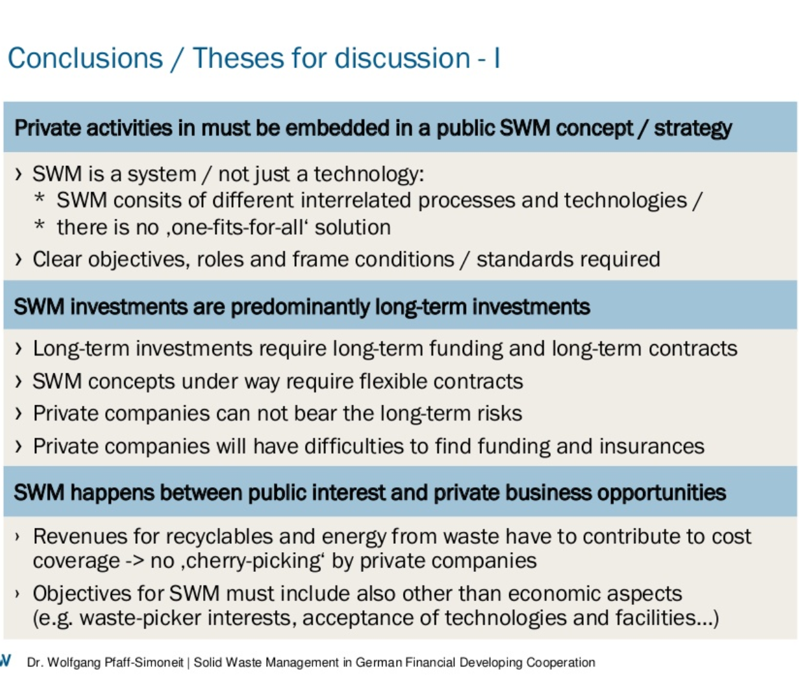
A FUNDER’s PERSPECTIVE

Slide 37
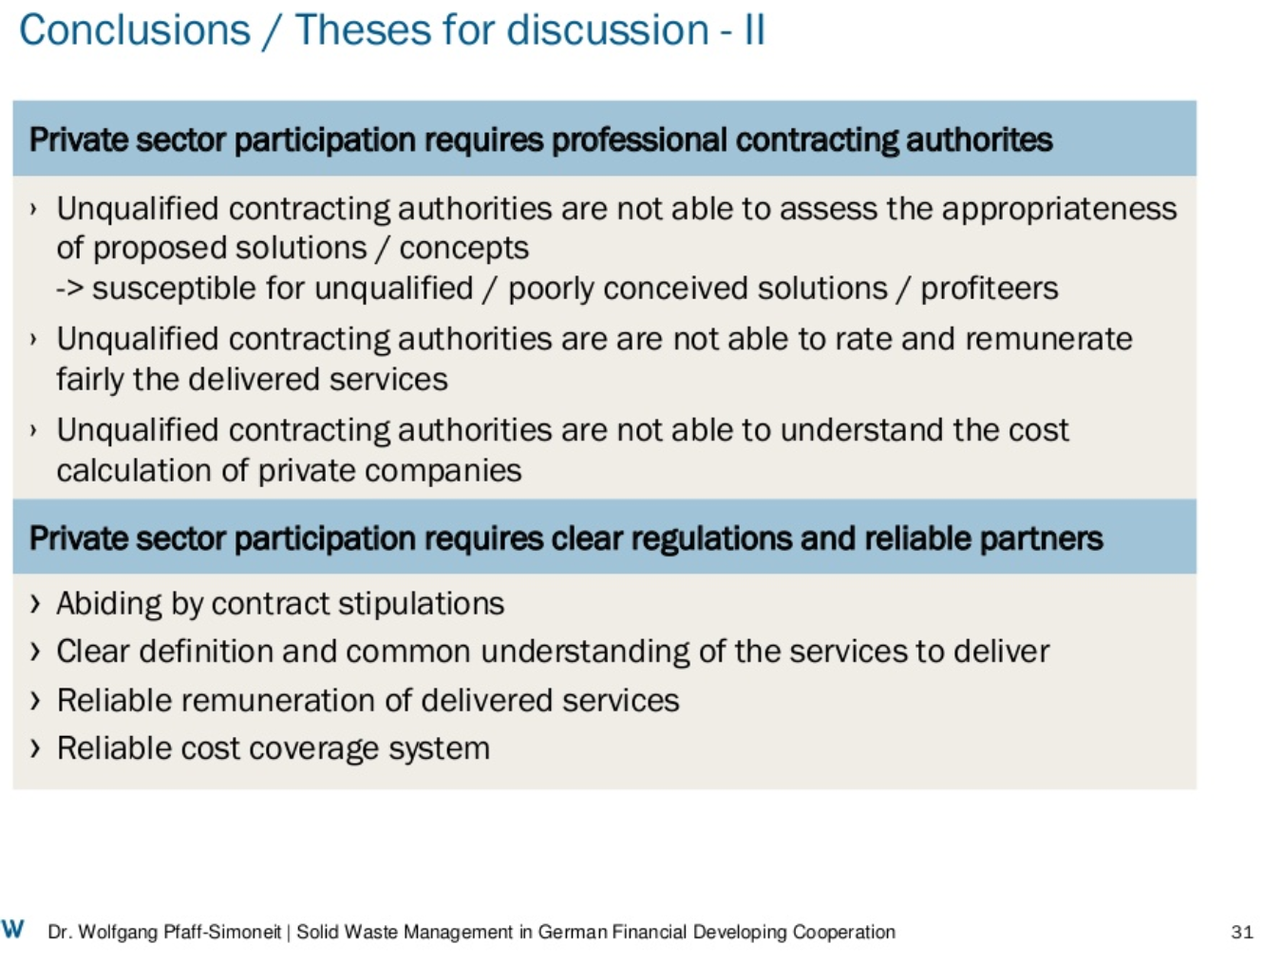

Slide 38
Full Cost Accounting includes:
Up-front costs comprise the initial investments and expenses necessary to manage SWM services: land acquisition; approval process; construction and modification of facilities; plants and infrastructure; support services provided by other local government departments;
Operating costs are the expenses of SWM on a daily basis;
Back-end costs include expenditures to properly wrap up operations and take proper care of landfills and other SWM facilities at the end of their useful lives. Cash outlays for back-end costs are not made until after the useful life of the facility has ended, those costs are said to be “accruing” (‘accumulating’) during the active life of the facility. They include:
costs of closure and long-term care
decommissioning of buildings and equipment
post-operating of landfills
retirement and post-employment health benefits for employees.

Slide 39
Whose costs should LAs include in the overall SWM system
After having defined the types of cost, we define the actors sustaining the costs that are to be included in the SWM accounting system:
  the City and the Local Authorities providing the SWM service and related services, such as accounting, billing, SWM design;
  public or private sector providers of SWM activities which should – by legislation - be provided by the Local Authority
  citizens’ self-providing expenses, such as privately owned containers, when these should be part of the provided public service
  the informal sector providing services which are part of an effective SWM’s objectives and targets, such as recycling
  volunteer and nongovernmental groups performing actions which are part of the regular SWM activities: such as information campaigns agreed with the local administration.

Slide 40
Investment costs
+
Large maintenance costs
+
Cost of the use of capital
FINANCING GAP
International public transfers
Voluntary contributions
Repayable finance:
commercial loans, bonds, equity, concessionary loans
Overheads
Tranfers
Operating and maintenance
Taxes
Materials and energy recovery from waste
public funds
SWM service tariffs
private funds
costs
revenues

Slide 41
Types of costs
The types of costs to be reported on an annual basis are:
Direct costs. Operating and maintenance are the recurrent expenses to provide SWM services. Maintenance costs are the routine expenditures needed to keep the system running at design performance, but don’t include major repairs or renewals.
Overhead: costs common across SWM activities such as accounting, billing (allocated according to partitioning principles, such as percentage of labour cost).
Capital Investments /Amortization: must be accounted to finance infrastructure expansion, rehabilitation, capital funding to ensure long-term sustainability of service:
  cost of designing the alternative scenarios and the needed investment, this phase might require the support of consultants external to the administration
  administrative costs of the approval process
  actual cost of the investment
  cost of the use of the capital
  reserves set aside for future investments.
Large facilities and plants maintenance costs

Slide 42
The introduction of new facilities and plants requires high expenses, both in the design and the infrastructure building phases and there is often going to be a gap “between the capital expenditure requirement and the fund availability with the city governments.”
If the structure of cost is not completely understood and funding sources adequately secured this funding gap “has the potential to result in delays to or abandonment” of the project. (CDIA, KPMG. 2010).
Cash flow
Construction phase
major maintenence
design phase
Estimated costs and budget allocated
approval phase
O&M expenses
time of SWM project’s development and use of infrastructure
cash out flow during the different phase of a SWM project requiring the construction of facilities and plants

Slide 43
Types of revenues to be reported on an annual basis are:
A .Service tariffs are funds contributed by service users to service providers. Tariffs are collected from different waste generators, such as households, restaurants, industrial premises. They can be collected in different ways.
B. Materials and energy recovery from waste: these revenues are generated when specific organisation schemes, facilities and plants are operating, they may not be available in ineffective SWM system. The operation of the chain for the recovery of materials from waste usually is a net cost of SWM, because the revenues from the sales of recyclable do not cover the cost of segregated collection, transport and the operation of the sorting and re-processing plants. When segregated collection and sorting are carried out by the informal sector, this actually represents a saving in the city’s collection cost.
C. Taxes refer to funds originating from domestic taxes that are transferred to the SWM sector from any level of government – national, regional or local.
D. Transfers refers to funds from national government; such funds would typically be provided as subsidies for capital investment or operations.

Slide 44
Types of revenues to be reported on an annual basis are (contd.):
External sources may include the following:
E. repayable finance: includes bank loans, commercial finance, microfinance, equity; these funds are provided by investors with the expectation that they would be repaid and would earn a rate of return on the capital invested. Bonds are sold on the market to a large group of bond investors; bond issuers may include cities (municipal bonds) or public and private companies (corporate bonds). Concessionary grants are loans from donors that would include a grant or transfer element in the form of an interest rate below market rate, or a grace period.
F. International public transfers: voluntary donations (or grants) from public donors and multilateral agencies that come from other countries.
G. Voluntary contributions (or grants) from international and national non-governmental donors including from charitable foundations, non-governmental organizations (NGOs), civil society organizations and individuals (remittances).

Slide 45
Organise the cost accounting system to support decision making
The overall goal of a SWM costs/revenues accounting is not to burden the administration with a new tasks but to ensure that the information and data generated provide an understanding of how the SWM system is operated so as to control its effectiveness and strengthen policy-making.
“Different decisions often require different cost data” (UN-Glass, WHO. 2016).
The main types of cost information needed by policy-makers in SWM are:
the total cost of the current SWM system, the proportion covered by service tariffs and if the tariffs collection should and could be increased
how are the costs distributed in the SWM service and where inefficiencies occur, so that it becomes possible to intervene to reduce costs: useful indicators could be the “cost per activity per user” or “cost per sub-service per tonnes of waste collected”
how to finance the step-by-step evolution of an ineffective or scarcely integrated SWM system and what external funding sources could be activated.

Slide 46
To support decision-makers and SWM managers, the accounting office could organise the voices of cost and revenues in two ways, providing two types of tables:
A Table in which costs and revenues are associated to each activity of SWM:
  collection
  transport
  transfer station
  recycling
  composting
  anaerobic digestion
  landfilling
  thermal treatment
  pre-treatment of residual waste

Slide 47
WASTE FLOWS of a schematic INTEGRATED SWM system
RESIDUAL WASTE to LANDFILL
RESIDUAL WASTE to SANITARY LANDFILL with BIOGAS and ENERGY RECOVERY
WET FRACTION from MBT to LANDFILL
FERROUS
REPROCESSING
FE from MBT to RECYCLING
RESIDUAL WASTE from “door to door”
RESIDUAL waste to TREATMENT
PRE-TREATMENT of RESIDUAL WASTE
DRY FRACTION from MBT to ENERGY RECOVERY
to FE RECOVERY
FERROUS
REPROCESSING
Understand and describe the SWM system by activities
RESIDUAL WASTE from STREET CONTAINERS
RESIDUAL WASTE to THERMAL TREATMENT
THERMAL TREATMENT with ENERGY RECOVERY
FLY ASHES to LANDFILL
HAZARDOUS WASTE to LANDFILL
BOTTOM ASH to RECOVERY
OTHER
HOUSEHOLD WASTE
RECOVERY of BOTTOM ASH
SANITARY LANDFILL with ENERGY RECOVERY
SORTING PLANT for DRY FRACTIONS RECYCLABLES
REJECTS from SORTING to LANDFILL
SEGREGATED COLLECTION of DRY FRACTIONS
DRY FRACTIONS
to TRANSFER STATION
PAPER
REPROCESSING
TRANSFER STATION
to REPROCESSING
INTERNATIONAL TRANSPORT of RECYLABLES
REJECTS from SORTING to ENERGY RECOVERY
COLLECTION CENTRES
PLASTIC
REPROCESSING
OTHER FRACTIONS to TRANSFER STATION
II° SORTING PLANT for PLASTICS RECYCLABLE
COMMERCIAL / BUSINESS WASTE
PRIVATE CITIZENS to COLLECTION CENTRES
GLASS
REPROCESSING
to REPROCESSING
SEGREGATED COLLECTION of FOOD WASTE
to COMPOSTING or ANAEROBIC DIGESTION
COMPOST to MARKET
COMPOSTING PLANT
SANITARY LANDFILL with ENERGY RECOVERY
ORGANIC REJECTS to LANDFILL
ANAEROBIC DIGESTION PLANT
with ENERGY RECOVERY
from BIOGAS
DIGESTATE to MARKET
GREEN WASTE SEGREGATED COLLECTION from PUBLIC PARKS
to COMPOSTING or ANAEROBIC DIGESTION

Slide 48
Cost per activity | STREET SWEEPING | COLLECTION | TRASPORT 1ST dstnt | TRASPORT FURTHER destinations | TRASFER STATION | SORTING PLANT | COMPOSTING | ANAEROBIC DIGESTION | THERMAL TREATMENT | LANDFILL | PRE-TREATMENT | TOTAL per COST TYPE
Operating & maintenance
fuels and goods
personnel
cleaning
services from private providers
rentals
Overheads
budgeting and administration
billing
information campaigns
Investment / Capital
DEPRECIATION of new fixed assets acquired by investment (building, plants, equipment)
DEPRECIATION of pre-existing fixed assets (building, plants, equipment)
Investmentand capital cost
Large capital maintenance cost
Annual RESERVES for future investments
Revenues: sales of materials |  |  |  |  |  | X | X | X
Revenues: sales of energy |  |  |  |  |  |  |  | X | X | X
TOTAL per ACTIVITY

Slide 49
The criteria to set up an effective SWM accounting system
keep SWM accounting separated from other services, other expenses, other service tariffs and other taxes waste generators and citizens might assume that SWM costs virtually nothing and does not depend on the amounts they generate;
Designate a dedicated Unit /Office in charge of keeping the accounting and collecting data from other Offices;
define by legislation the sources of waste to be included in the service provided by the Local Authority and the criteria for billing: households; commercial, business, industrial, …;
organise the cost and revenues data in accordance with the description given by the waste flow analysis of the existing SWM system: this gives an accurate and complete list of SWM activities and sub-services provided;
estimate the full cost of alternative SWM scenarios on the basis of their waste flow analysis, to assess their financial feasibility
use techniques such as depreciation and amortization which produce a more accurate picture of the costs of SWM current and future systems, without the distortions associated to focusing solely on a given year’s cash expenditures.

Slide 50
Financial analysis
An essential element that is regularly reviewed is the structuring of the project, particularly if that structuring involves a private-sector operator who helps to mitigate some of the project’s risk and operational costs.
For capital and large secondary cities in developing countries, the primary challenges can be lumped into the following categories:
Defining the status of a project’s development : concept; initial engineering or financial feasibility;
Articulating, in language focused on execution of the project, the financial feasibility of a program, regardless of the ultimate sources of capital selected;
Accessing finance from charitable foundations, donors and other aid agencies to develop projects and demonstrate financial feasibility;
Establishing creditworthiness, financial responsibility, and integrity of municipality as a lead agency (regardless of intended status as borrower or partner in a public-private partnership);
Understanding instruments and tools available for cities seeking to finance municipal SWM initiatives.

Slide 51

Simonetta Tunesi - UNIDO
Strategic Environmental Consulting
Bologna – ITALY
simonetta.tunesi@gmail.com

Slide 52
Waste management organisation, available facilities and plants, existing SWM capacity
Main characteristics of facility / plant
site location details | Address ; geographical coordinates
details on property and management | …contact details
Type of facility and technology adopted | Transfer Station Sorting plant Composting plant Anaerobic digestion: dry; semi-dry…. Landfill Thermal Treatment plants: incineration; gasification.. MBT (pre-treatment mechanical biological)
overall capacity for recycling | Presence of reprocessing plants for the different waste fractions: paper, plastics; glass, aluminium;…
Capacity of treatment or storage (for landfills) | amount authorised (tonnes per year) amount treated /stored (tonnes per year)
For each source of waste treated | Amount (tonnes/hour; tonnes/year) Source of waste
types of rejects generated | Amount (tonnes/month, tonnes/year) Destination: such as landfill, energy recovery
amount and type of energy recovered | kcal/year or MJ/year
authorisation permit details | capacity (tonnes/year, tonnes/day) types of waste and amount best practices requested
site lifetime or remaining capacity | years remaining; capacity/year

